Slide 1
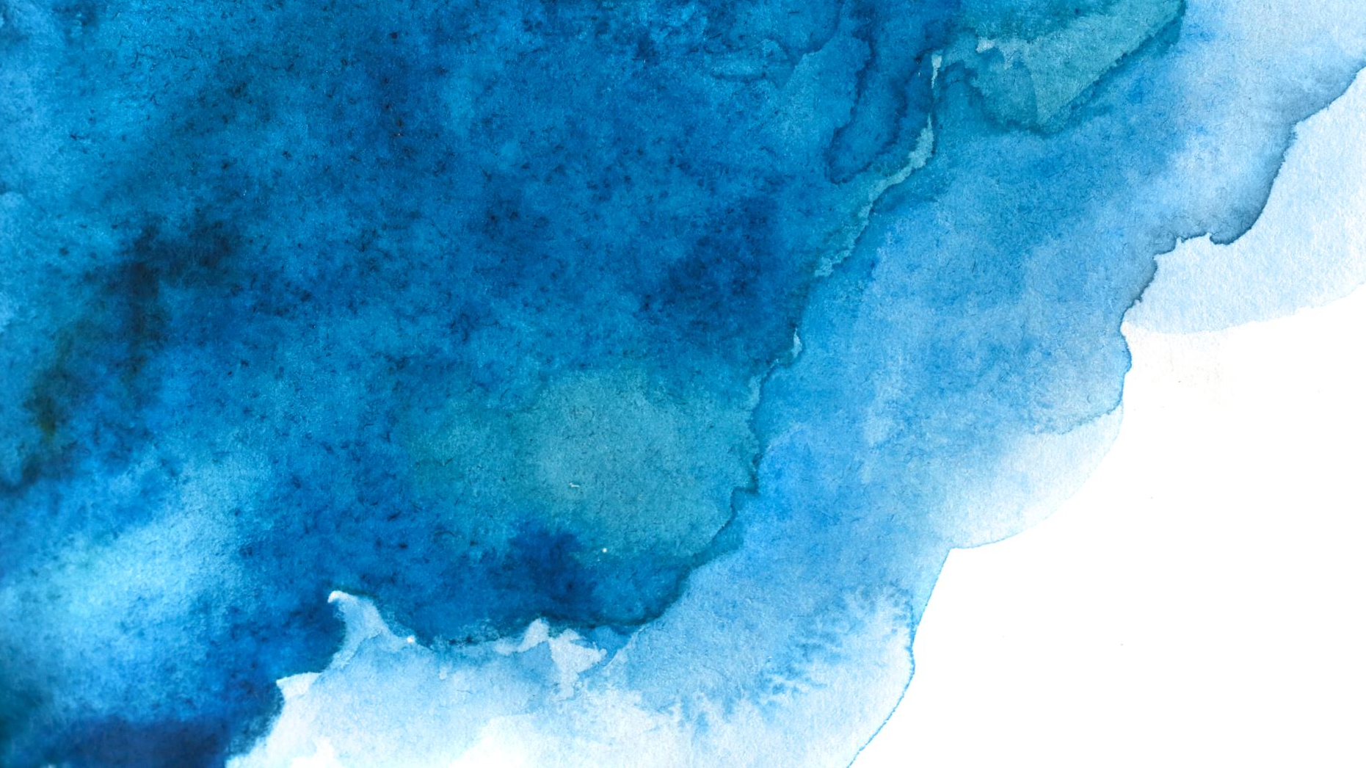
Tracking algal blooms in Lake St. Clair 2015-2020
Bryce Deckard – Adv Remote Sensing

Slide 2
Introduction/Purpose
Blooms are caused by bacteria called Cyanobacteria. These bacteria naturally occur in lakes, ponds, and rivers. However, with the right conditions, these Cyanobacteria can rapidly form Cyanobacterial blooms also known as Harmful Algal Blooms.
These Harmful Algal blooms can contain Cyanotoxins which make people sick. This can occur from drinking water contaminated with algae, touching the algae, or breathing in the toxins. These toxins also affect pets, livestock, and fish.
Algal blooms on Lake St. Clair have been getting more common and more severe over the years
Goal – I want to use NDVI from MODIS imagery to detect algal blooms across different seasons and years.

Slide 3
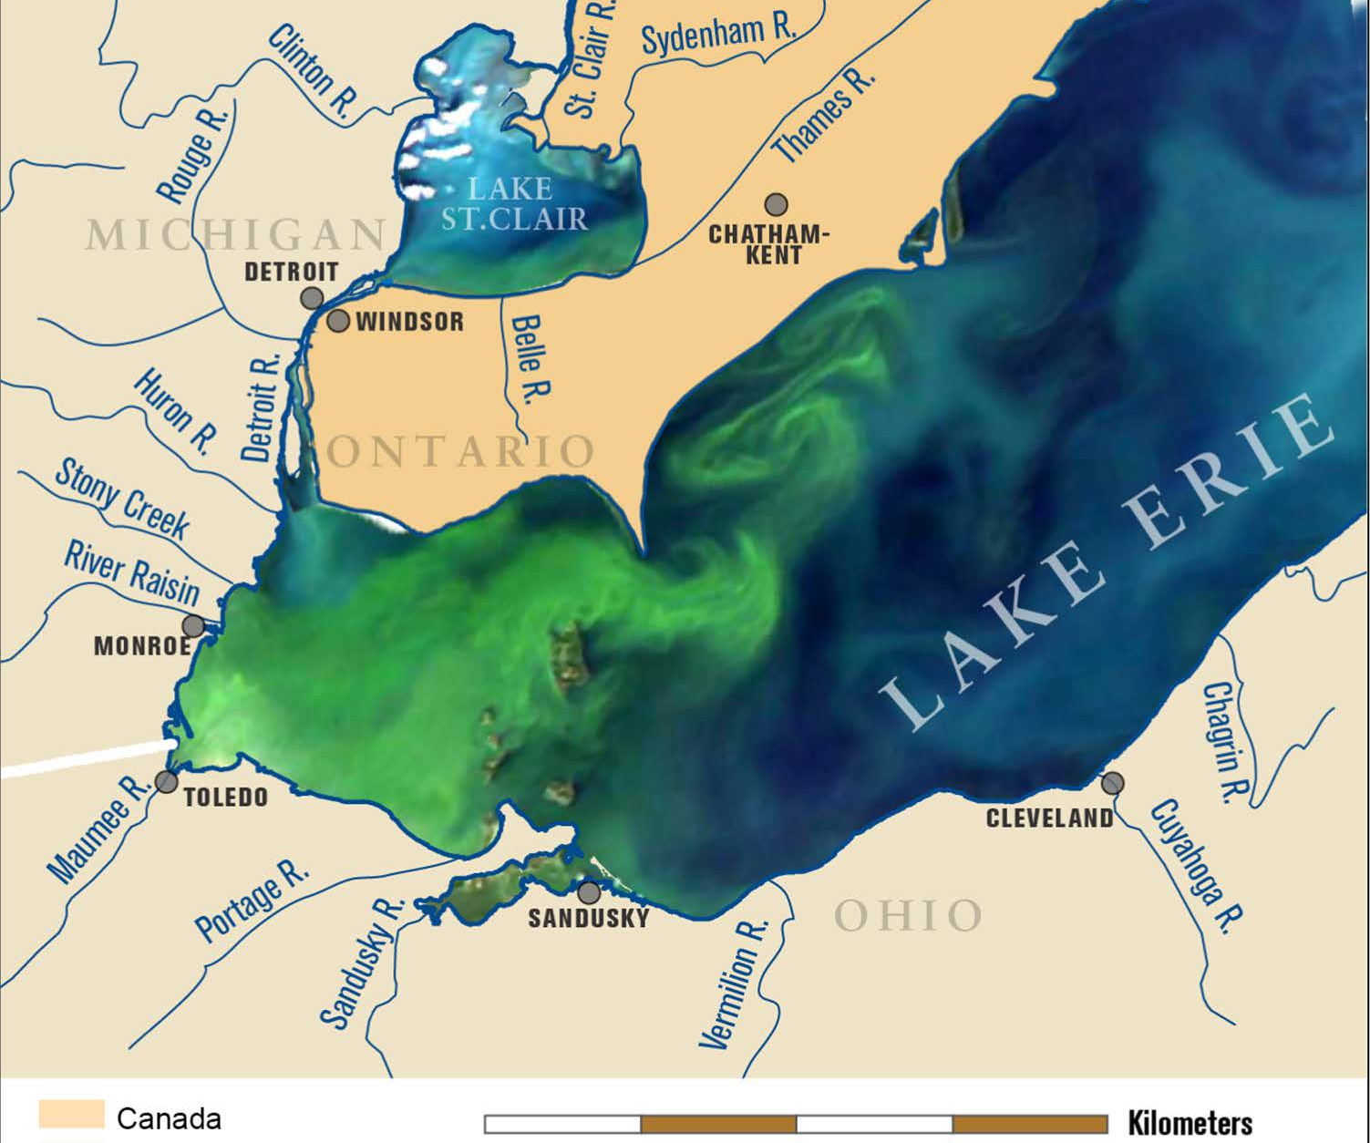
Adjustment from last project
For my final project in the introduction to RS class I used Lake Erie as my study area
Unfortunately, due to the limitations of the free version of GEE I had to pick Lake St. Clair as it was smaller.
However, this is still important because much of the algae in Lake Erie originates from Lake St. Clair and the chemicals that flow through the Detroit River connecting the two lakes.

Slide 4
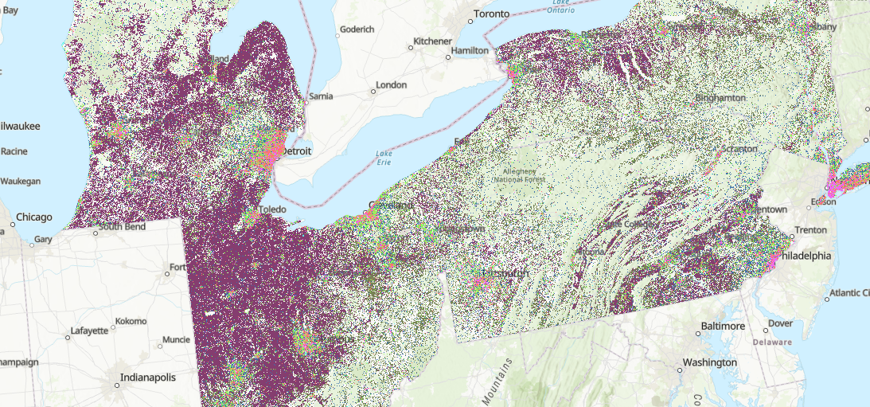
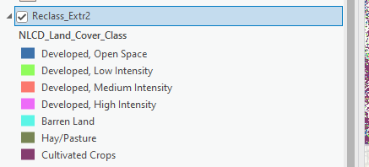
Land use in the region
-This map was created using Landsat 8 imagery. It shows land use by category. I reclassified and picked what classes to include.
-This shows us that the land use category adding to the algae the most is the cultivated crops/developed areas.
-Not the best to demonstrate where the nutrients come from because it doesn’t include Canadian land use.

Slide 5
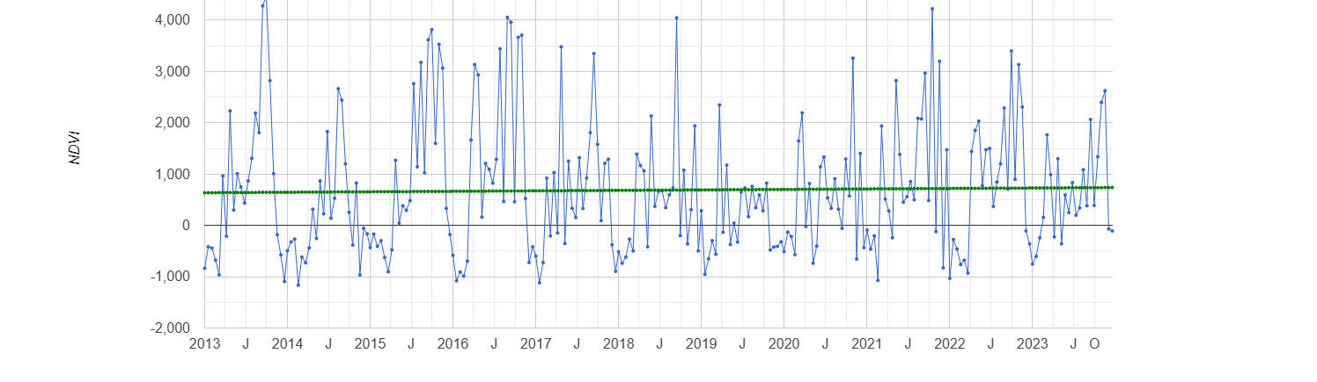
Ndvi time series chart of lake St. Clair
Created this chart by drawing a polygon around Lake St. Clair to create a ROI. This was important because the previous chart I created was skewed by land pixels
NDVI is highest in the summer and lowest in the winter which makes sense based on the seasonality of temperature, sunlight, and available nutrients in Lake St. Clair

Slide 6
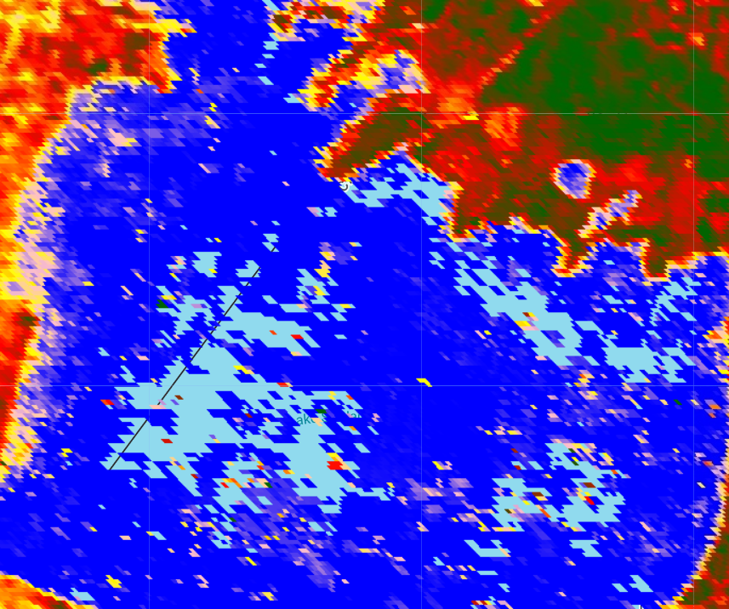
Initial Summer 2015 NDVI Map
For this map I used MODIS imagery from June 1st , 2015 – September 30th, 2015
The red/orange pixels represent algae or vegetation
This visualization of algae blooms in this map wasn’t ideal. Hard to differentiate shoreline vegetation and open water

Slide 7
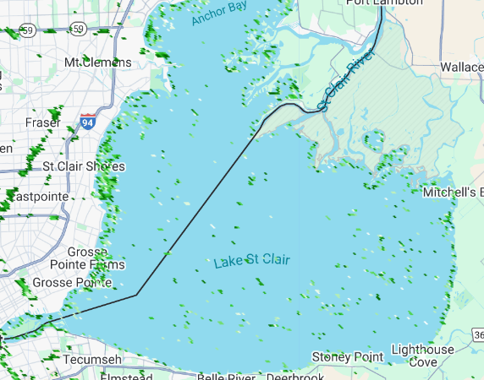
Filtered ndvi image of Summer 2015
For this image I used a threshold filter of 1500-3500 which corresponds to NDVI values of 0.15 to 0.35
This filter works because NDVI for open water is around 0 and 0.4 is too low for most land vegetation meaning this filter should only show floating algae or turbid water
Still limited by the 250m resolution of MODIS

Slide 8
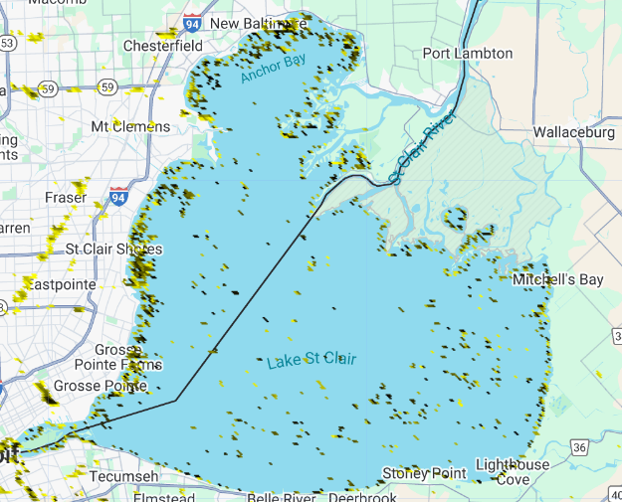
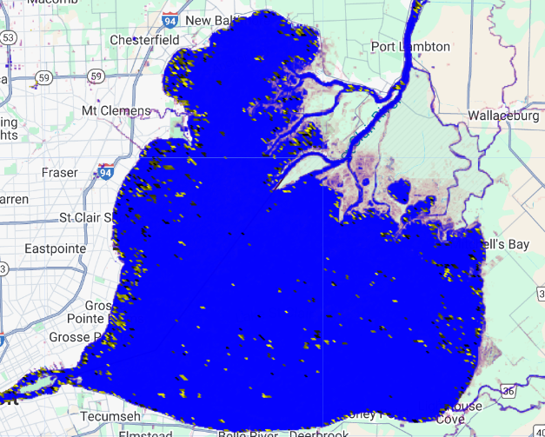
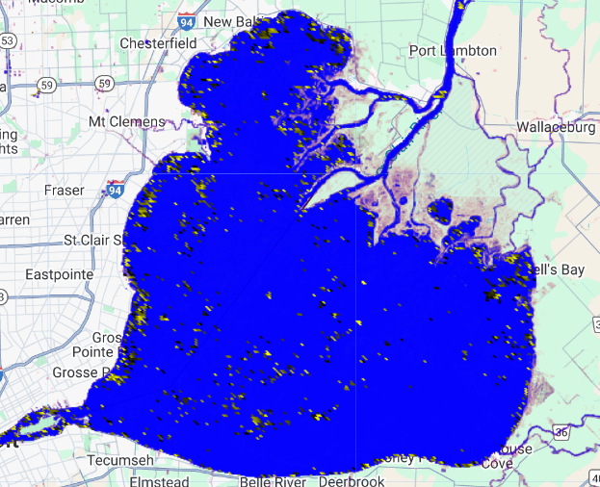
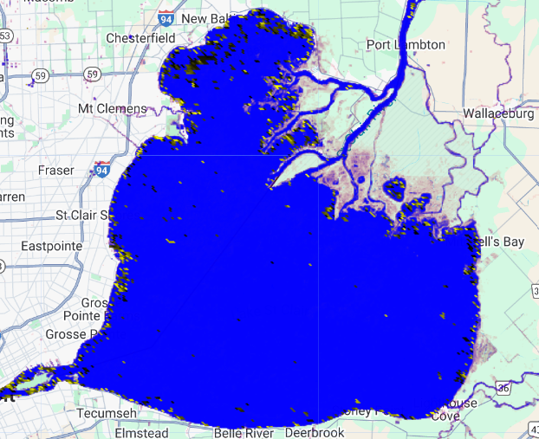
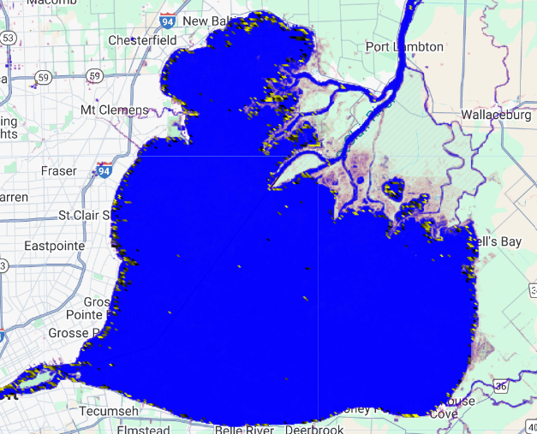
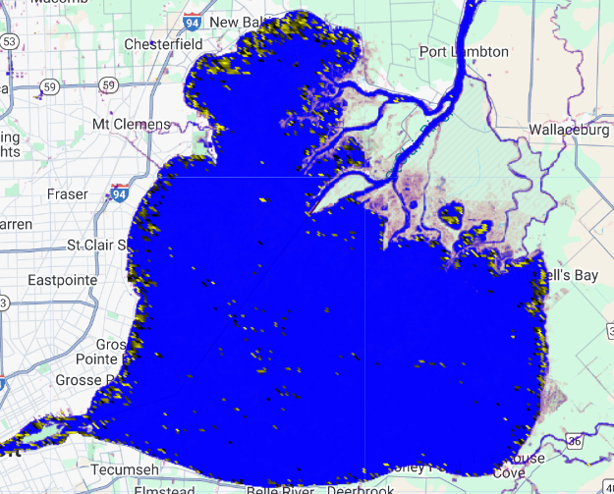
Algae bloom change over time summer 2015-2020
Applied a consistent threshold across all years.
Added a new land filter that helps highlight just the water pixels for the maps after 2015.
2015 and 2017 have the most algae shown, but 2018 had a heavy concentration of algae at the top of Lake St. Clair. Could possibly be explained by the St. Clair river.

Slide 9
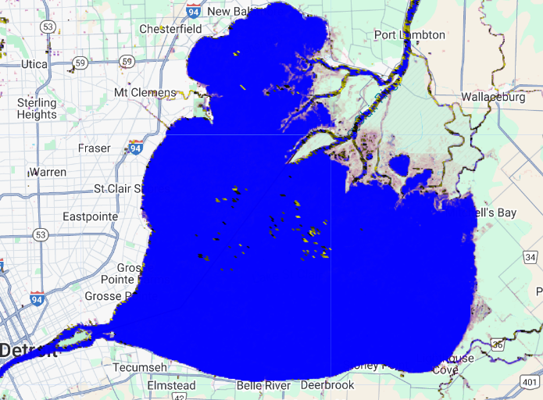
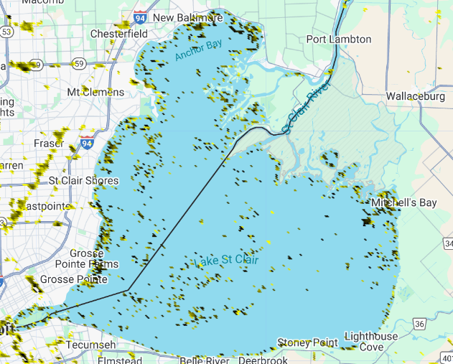
Winter vs summer 2017 NDVi
-To show the seasonal impacts of weather on the algae blooms. I compared the 2017 winter to 2017 summer
- The winter threshold was the same as the summer threshold which caused lots of interference. To solve this, I used the JRC global surface water dataset to create a new filter. This uses a filter that determines if a pixel is water or not based on that pixel's values since 1984

Slide 10
Conclusion
NDVI can be a useful tool to detect floating algal blooms using the reflectance values from the MODIS images
Certain limitations along shorelines due to the 250m resolution of MODIS limiting the accuracy of the NDVI
Algae was most visible in the summer months and was significantly less prevalent in the winter
Using a land mask filter like the JRC surface water dataset help eliminate shoreline vegetation or other pixels being falsely represented as algae
The concentration of algal blooms in certain years such as the summer 2018 image shows that the local land use and hydrology can change the distribution of the algal blooms
We could improve the situation in Lake St. Clair by addressing the runoff of nitrogen and phosphorus from nearby agricultural zones. This could be done by helping farmers with their runoff problems, or by-passing legislation outlining safe phosphorus and nitrogen levels. Therefore, helping clean the water that millions rely on for drinking water and helping local tourism

Slide 11
Works cited
Jacques, Justin. “Op-Ed Urges Green Measures for Cost-Effective Stormwater Management.” Stormwater Report, 6 Dec. 2017, stormwater.wef.org/2017/12/detroit-free-press-op-ed-urges-green-measures-cost-effective-stormwater-management/.
National Oceanic and Atmospheric Administration. (n.d.). Great Lakes harmful algal blooms (HABs). Retrieved from https://oceanservice.noaa.gov/hazards/hab/great-lakes.html#:~:text=These%20blooms%20may%20cause%20fish,Erie%20from%20July%20to%20October.
Alliance for the Great Lakes. (n.d.). Lake Erie Algae Blooms. Retrieved from https://greatlakes.org/campaigns/lake-erie-algae-blooms/
Esri. (n.d.). Harmful Algal Blooms in the Great Lakes. Retrieved from https://storymaps.arcgis.com/stories/5fccdbf3a18145c69c2b2eaf41d2f0c1?utm_source=gis-story&utm_medium=web&utm_campaign=splash&utm_content=MI-HABs-Storymap

Slide 12
Link to code
https://code.earthengine.google.com/0b030b36aa8c1fbb136ddeb0b3850a7d

